Slide 1
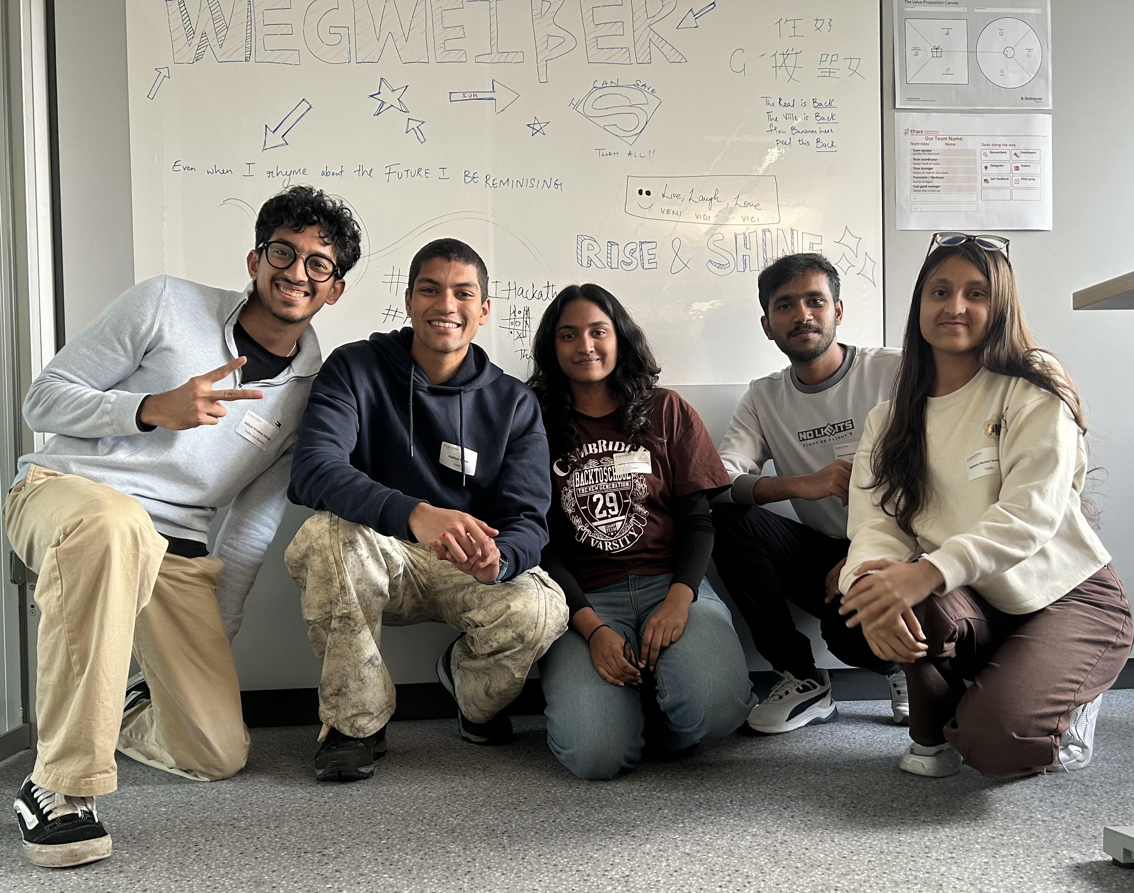

CARITAS UNTERFRANKEN
CaritAssist
Your support in Lower Franconia
Notes:
[Speaker 1 · ~15 s]
Hi, we are team CaritAssist. Our task from Caritas Würzburg: one simple question – 'I need help. Which Caritas service can support me, and why?' – answered by voice, in plain language.

Slide 2
THE PROBLEM
Finding RELIABLE help in crisis is hard.
49 Services
115 Local Offices
Delayed Help
Debts, addiction, pregnancy, care, migration … it is hard to know which one fits you.
Spread over 9 districts. Which office is responsible where you live?
People in distress need a direct phone number, not a directory search.
Notes:
[Speaker 1 · ~30 s]
Caritas in Lower Franconia is not one office. It is 33 different services and 115 local offices across 9 districts, run by Caritas and partner organisations. Someone in distress – with debts, an addiction in the family or an unplanned pregnancy – has to work out which service fits and which office is responsible for their town. That takes time they don't have. They need a phone number, not a directory.

Slide 3

OUR SOLUTION TODAY
We can fix that.
Introducing CaritAssist - finding the right help for you using AI
Understands Everyday Speech
Speak naturally in German or English – it asks back if needed.
Structured Caritas DB
49 services and 115 offices from all 9 districts of Lower Franconia – with contacts.
Direct Phone & Website Contact
Names the responsible office with phone and address – in your district.
Notes:
[Speaker 2 · ~25 s]
CaritAssist fixes that. You simply talk to it like to a person at a reception desk. It understands what you mean, picks the right Caritas service, and gives you the responsible office in your district – with phone number and address. Behind it is a structured Caritas database we built ourselves.

Slide 4


HOW IT WORKS
From one sentence to the right office
User Voice Input
„Ich habe so viele Schulden und weiß nicht mehr weiter. Ich wohne in Schweinfurt.“
CaritAssist Direct Result
Schuldner- und Insolvenzberatung · Kolping Bildungswerk Schweinfurt
Telefon: 09721 7389590
Fischerrain 2, 97421 Schweinfurt
Notes:
[Speaker 3 · ~30 s]
Here is a real example. Someone says: 'I have so many debts and don't know what to do. I live in Schweinfurt.' In about a second CaritAssist answers – out loud – with debt counselling, the responsible office in Schweinfurt, its phone number and address. This is the actual output of our system, straight from the database.

Slide 5





UNDER THE HOOD
Five steps, about one second
STEP 1
STEP 2
STEP 3
STEP 4
STEP 5
Listen
Safety first
Understand
Look up
Answer
Browser speech recognition, in German or English.
Crisis words → 112 and TelefonSeelsorge immediately, before any AI.
AI (gpt-oss-120b via Groq) picks 1 of 32 services – or asks one short question.
Our code finds the office in the user's district. The AI never writes phone numbers.
Text with office card, read aloud by a natural voice – with an offline backup voice.
Memory per conversation: follow-ups like “Kitzingen” or “Is it free?” are understood in context.
Notes:
[Speaker 3 · ~35 s]
Under the hood it is five steps. One: the browser turns speech into text. Two: a safety check – crisis words like suicide or violence get emergency numbers immediately, before any AI. Three: the language model picks one of our 32 services, or asks one short question if it really can't decide. Four: our own code – not the AI – looks up the office in the user's district, so it can never invent a phone number. Five: the answer appears and is read out by a natural voice.

Slide 6






WHAT WENT WRONG
Our failures – and how we fixed them
Whisper misheard German
Small model: 75% accuracy
Local speech-to-text turned German into vague text.
Fix: Browser speech recognition in de-DE.
The local 3B model mixed up similar services.
Fix: Free Groq model (95%) + backup key + offline fallback.
Messy website data
Voice slow or silent
Image credits as titles, missing phone numbers.
Fix: Cleaning rules – every filled value is flagged.
The online voice took up to 20 s or failed.
Fix: Streamed audio + instant offline voice (< 1 s).
Team of 5
Frontend 2 · Backend & LLM 2 · Whisper voice & pitch 1
One shared GitHub repository
Feature branches, merged together – one codebase for all
Notes:
[Speaker 5 · ~40 s]
Not everything worked at first. Our local Whisper speech recognition misheard German, so we switched to the browser's recognition. A small local AI only got 75% right, so we moved to a free hosted model with a backup key and an offline fallback. The website data was messy, so we wrote cleaning rules. And the natural voice was sometimes very slow, so we stream it and fall back to an offline voice in under a second. We were five: two on the frontend, two on backend and the AI, one on voice and this pitch – all in one shared GitHub repository.

Slide 7

CaritAssist
Connecting people in distress to local Caritas support — instantly and accurately.
Vielen Dank! Q&A
github.com/Adigateway/InclusivAI_voiceassist
Notes:
[Speaker 5 · ~15 s]
CaritAssist connects people in distress to the right local Caritas support – by voice, in seconds, and with real contact details. Vielen Dank – we're happy to take your questions.

